Slide 1
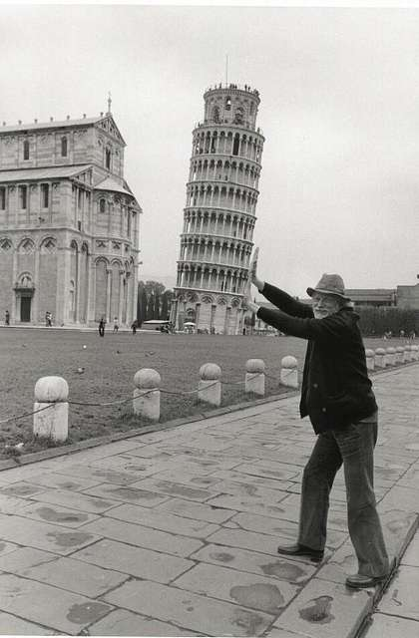
Test, adjust for, and report publication bias
SORTEE2022 workshop
11th July 2022

Slide 2


Yefeng Yang
Agricultural Engineer
Biologist by training
95% reconverted into:
Evidence synthesist
Meta-researcher
yangyefeng_0920@163.com

Slide 3


Malgorzata Lagisz
Evolutionary Ecologist
Ecotoxicologist by training
98% reconverted into:
Evidence synthesist
Meta-researcher
losialagisz@gmail.com

Slide 4


Alfredo Sánchez-Tójar
Evolutionary Ecologist
Ornithologist by training
95% reconverted into:
Evidence synthesist
Meta-researcher
@ASanchez_Tojar

Slide 5
Housekeeping:
We ask that all participants familiarize themselves with our code of conduct, available at SORTEE.org [co-host: share the link in the chat: https://www.sortee.org/codeofconduct/
For detailed information on all the events, please check “Conference Information Pack” [co-host: share the link in the chat: http://tinyurl.com/SORTEE2022ConferencePack
Some information about the conference is available at SORTEE.org/events, but this does not include links to events. You can find the list of all zoom links in a google sheet which you can also find in the Conference Pack or in the shiny app. We ask you to keep these zoom link private and ask anyone interested in joining to subscribe through our eventbrite page. [have co-host share link: https://tinyurl.com/SORTEE2022ZoomLinks and https://sortee2022.shinyapps.io/Program/ ]
Please note that follow up discussions will be happening in Slack. Please see the Conference Information Pack for information on how to navigate the conference Slack workspace [co-host: share the link in the chat https://tinyurl.com/Join-SORTEE-Slack
Please note that this interactive event is NOT being recorded, but we will make any notes or other products available, and the discussion in Slack will remain accessible after the event is over.
Finally, note that each of you can turn off or leave on the automatic captioning you see at the bottom of your screen by clicking on the live transcription button.

Slide 6
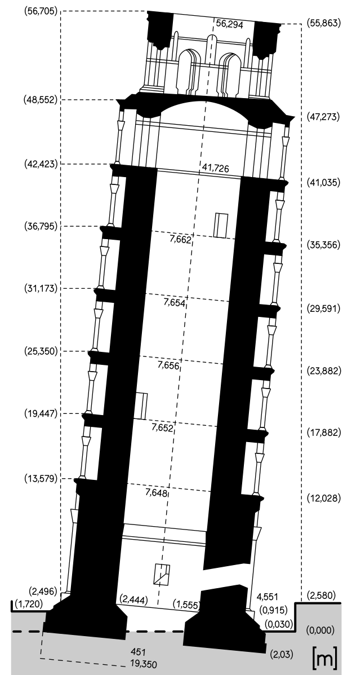
Workshop plan:
PRESENTATION 1:
Publication bias in ecology and evolution
PRESENTATION 2:
Publication bias tests – common practices
PRESENTATION 3:
Introducing a new method
PRESENTATION 4:
How does this look in R?
HANDS-ON:
Individual work with Rmd and code

Slide 7

Publication bias in ecology and evolution: super short mini intro
PRESENTATION 1:
Alfredo Sánchez-Tójar
11th July 2022
@ASanchez_Tojar

Slide 8
Take home message:
Publication Bias is
Commonplace,
You better test for it!

Slide 9
Types
Decline effects (AKA time-lag bias)
Small-study effects
More... e.g, citation biases

Slide 10
Decline effects

Slide 11

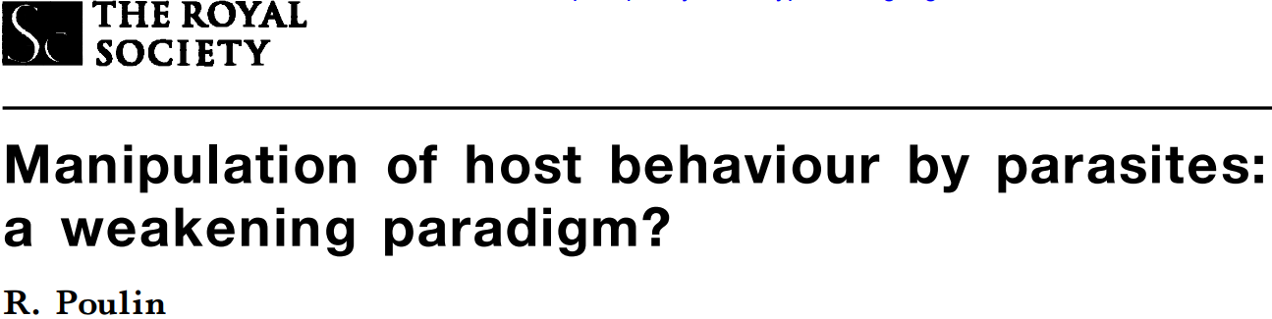
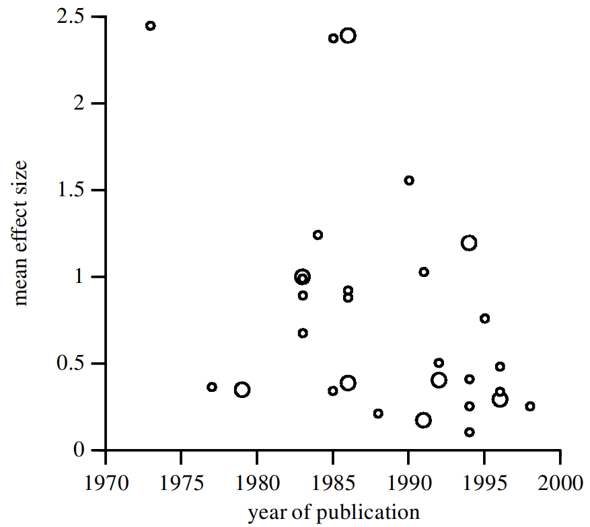
@ASanchez_Tojar
Decline effects
30 studies
Study averages
r = -0.41

Slide 12
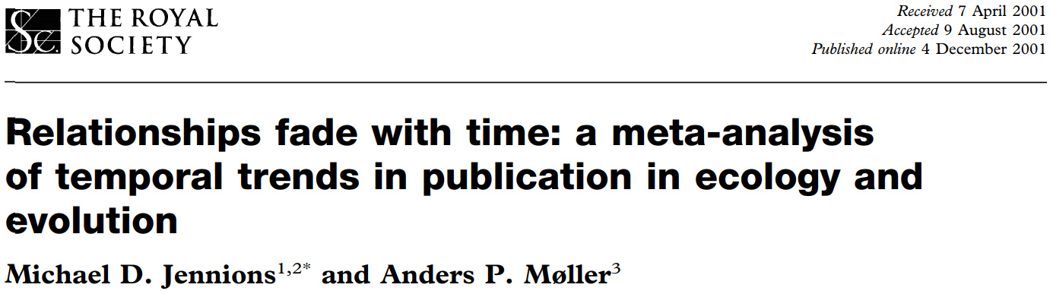
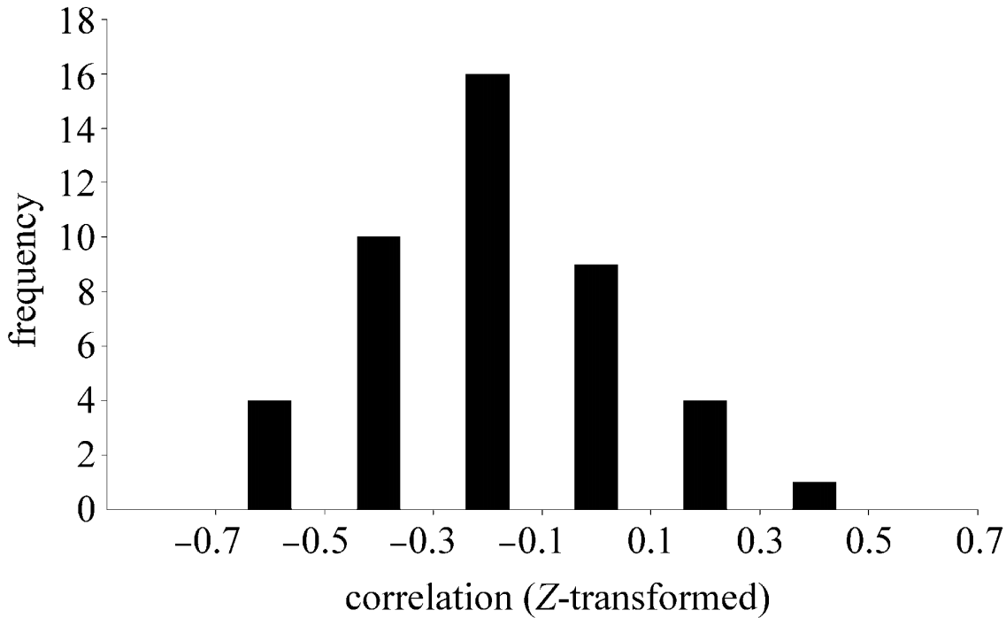
@ASanchez_Tojar
Decline effects
r = -0.07, n = 232 studies
r = -0.13, n = 44 meta-analyses

Slide 13
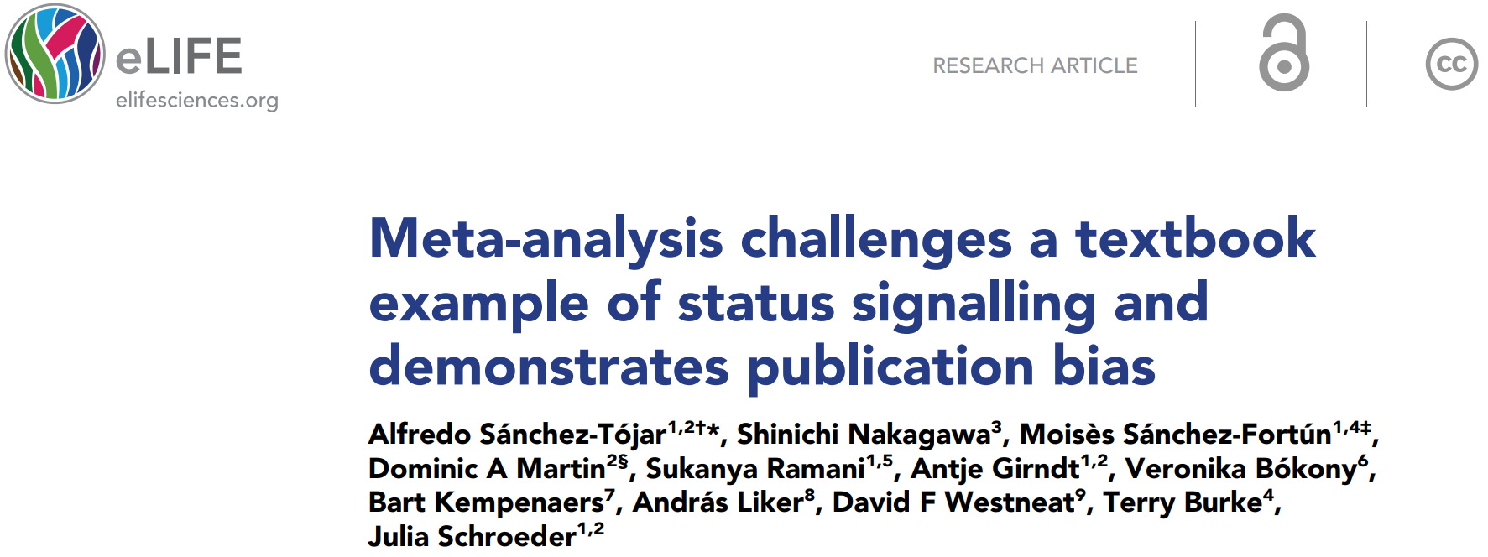
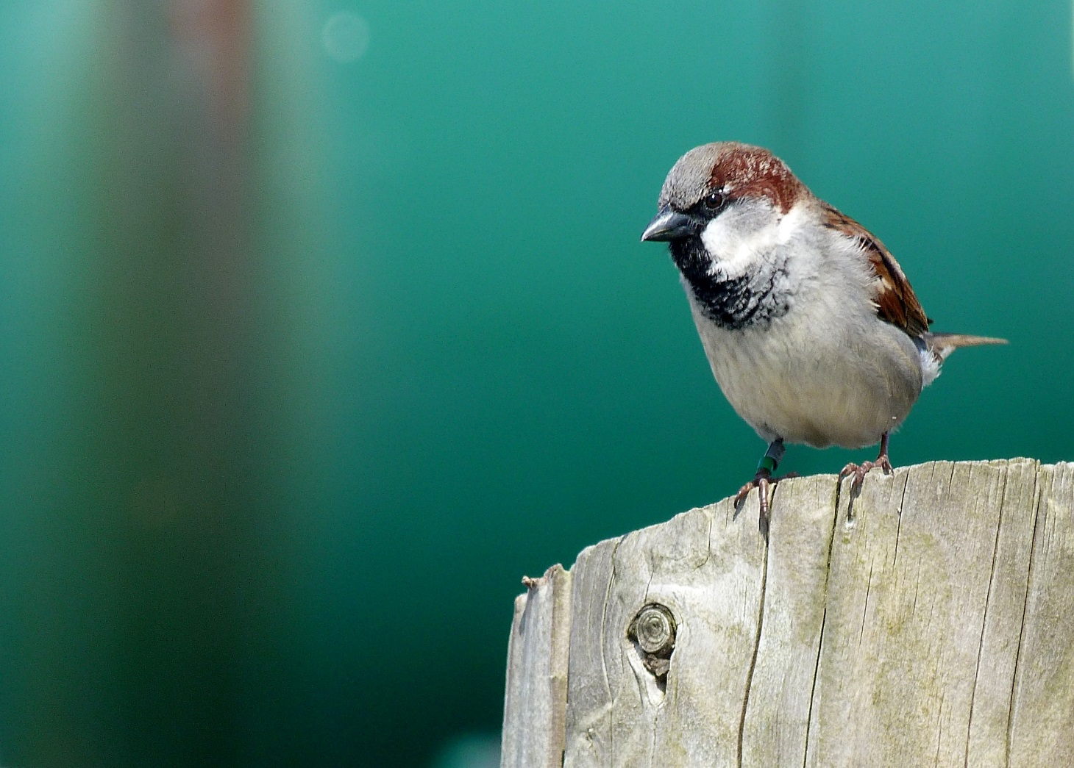
@ASanchez_Tojar
Decline effects
Bib size
12 studies
53 estimates

Slide 14
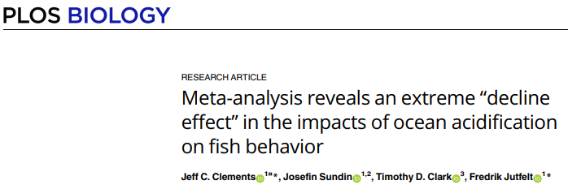
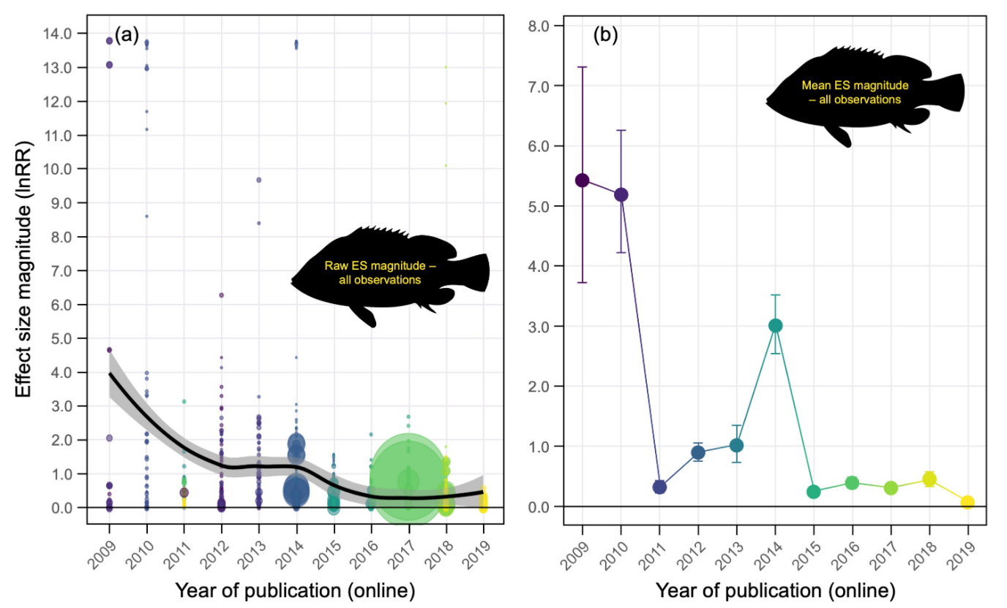
@ASanchez_Tojar
Decline effects
95 studies

Slide 15
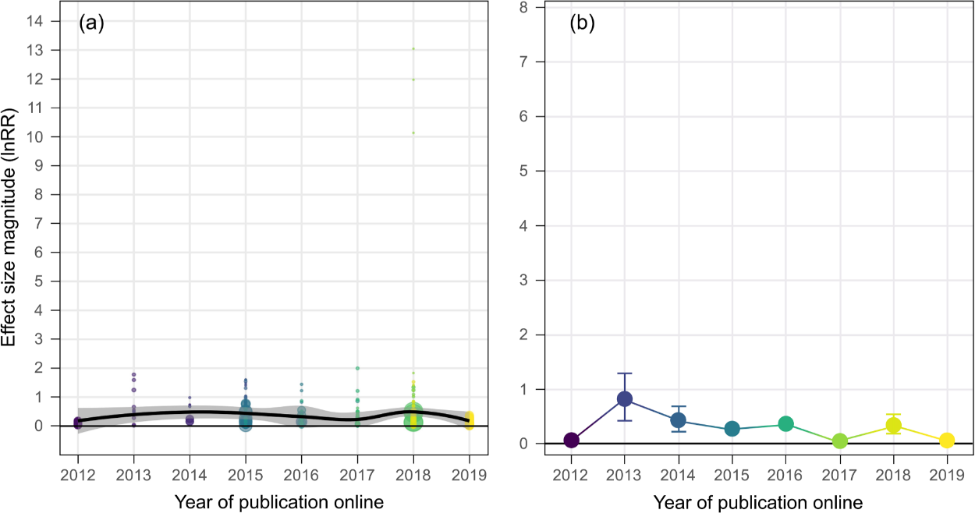
@ASanchez_Tojar
Decline effects
95 studies

Slide 16
Small-study effects

Slide 17
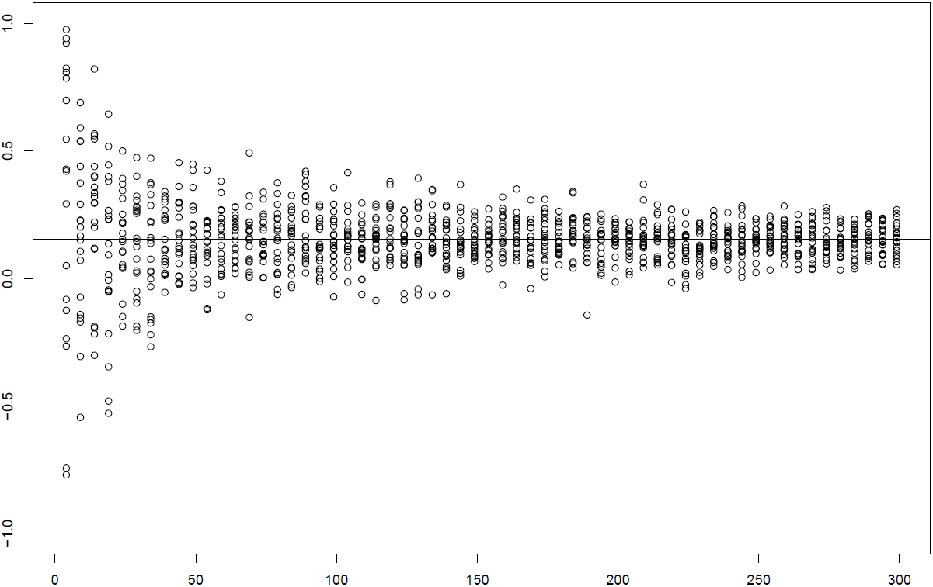
@ASanchez_Tojar
Small-study effects
N = 1198
r
sample size

Slide 18
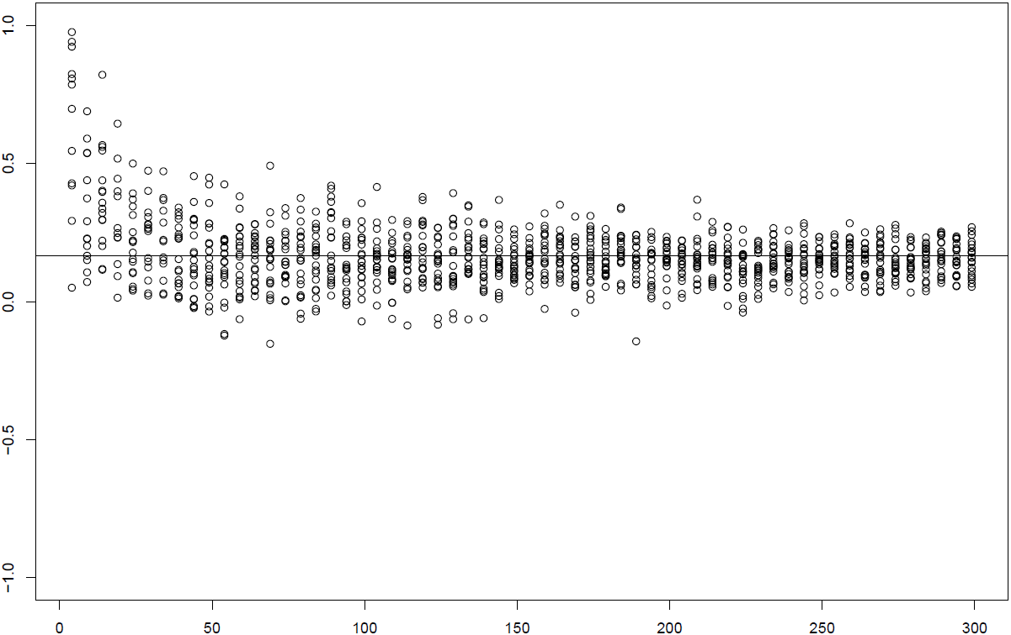
@ASanchez_Tojar
Small-study effects
N = 1158
r
sample size

Slide 19
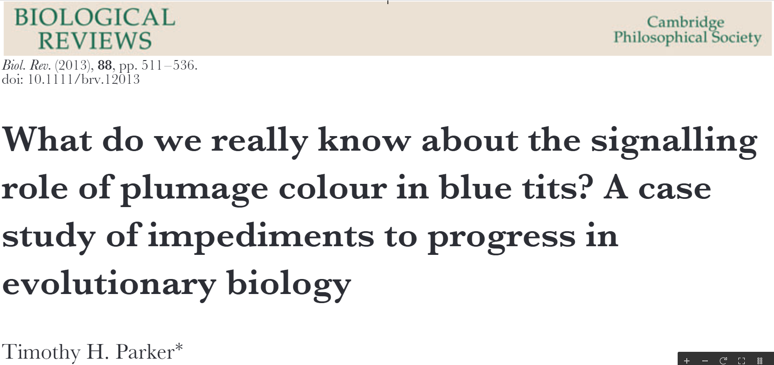
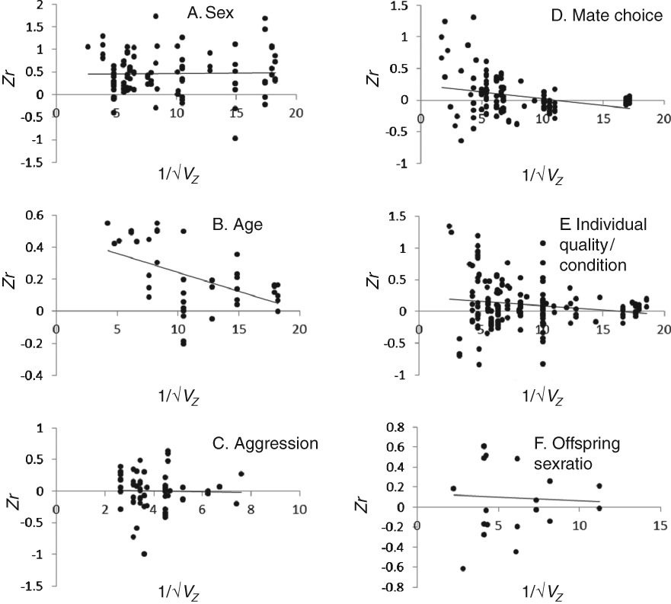
@ASanchez_Tojar
Small-study effects

Slide 20
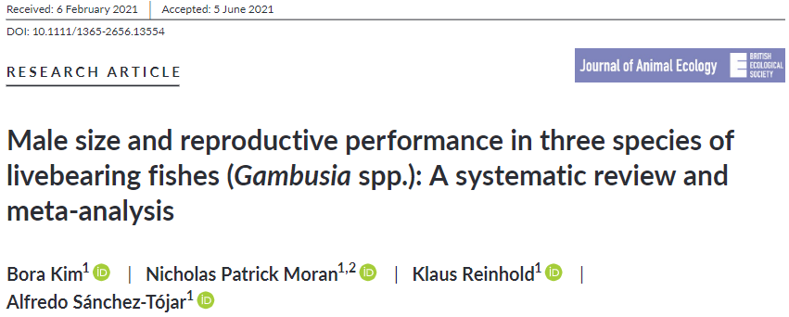
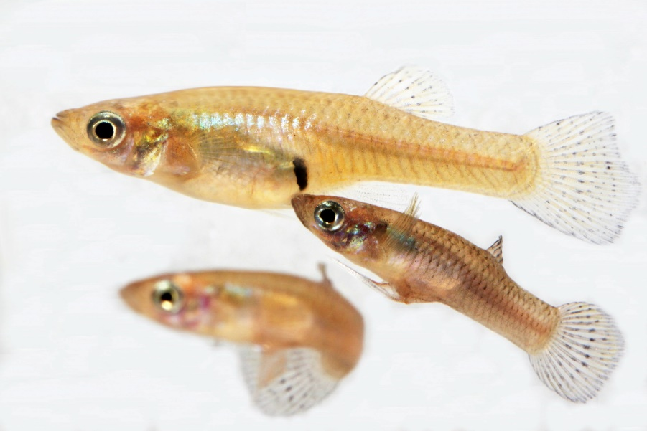
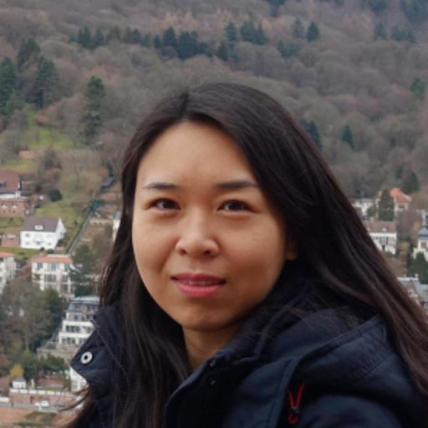
@ASanchez_Tojar
Small-study effects

Slide 21
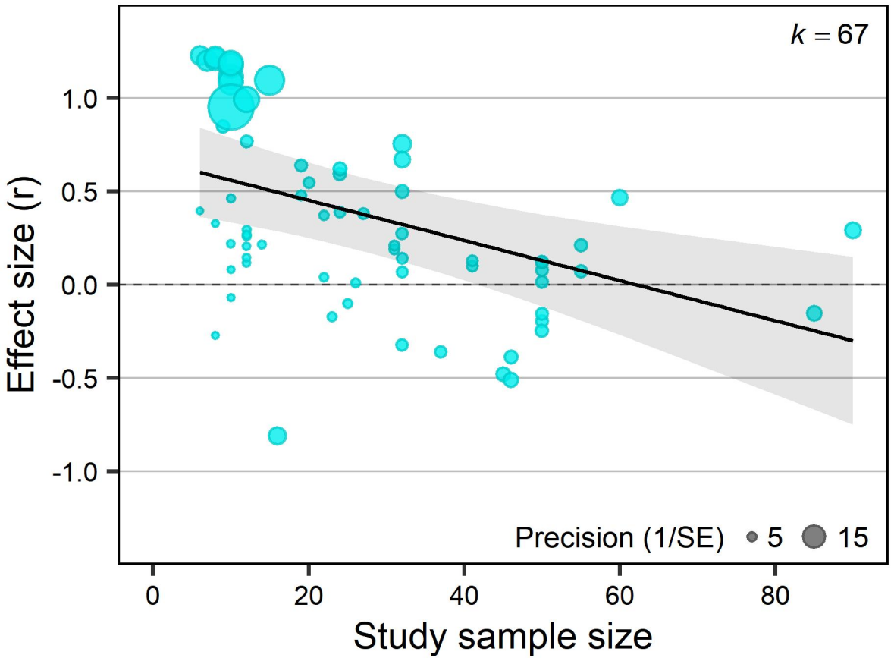
@ASanchez_Tojar
Small-study effects
n = 16 studies

Slide 22
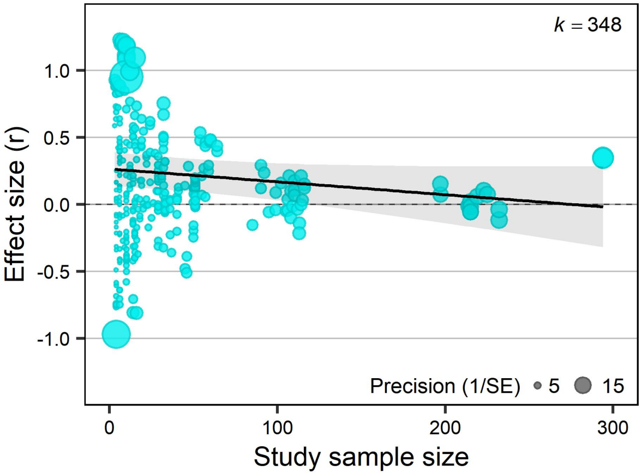
@ASanchez_Tojar
Small-study effects
n = 16 studies
n = 36 studies

Slide 23
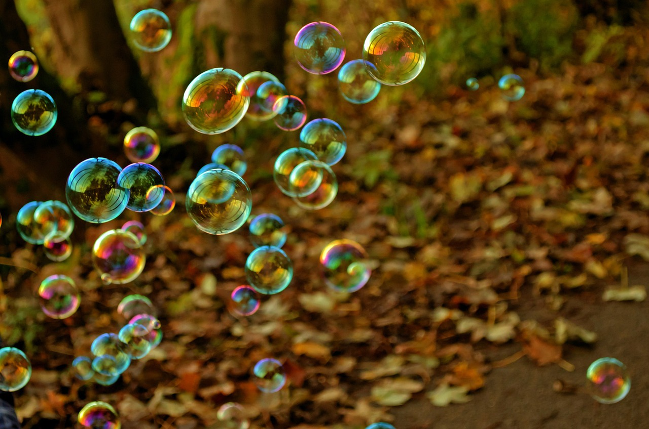

Slide 24
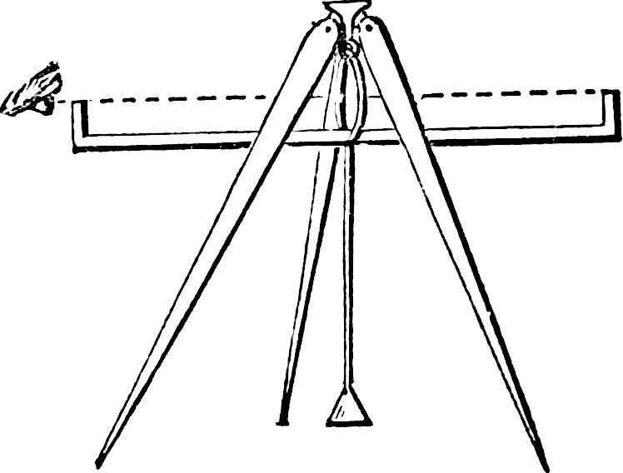
Publication bias tests – common practices survey results
PRESENTATION 2:
Malgorzata Lagisz
11th July 2022

Slide 25
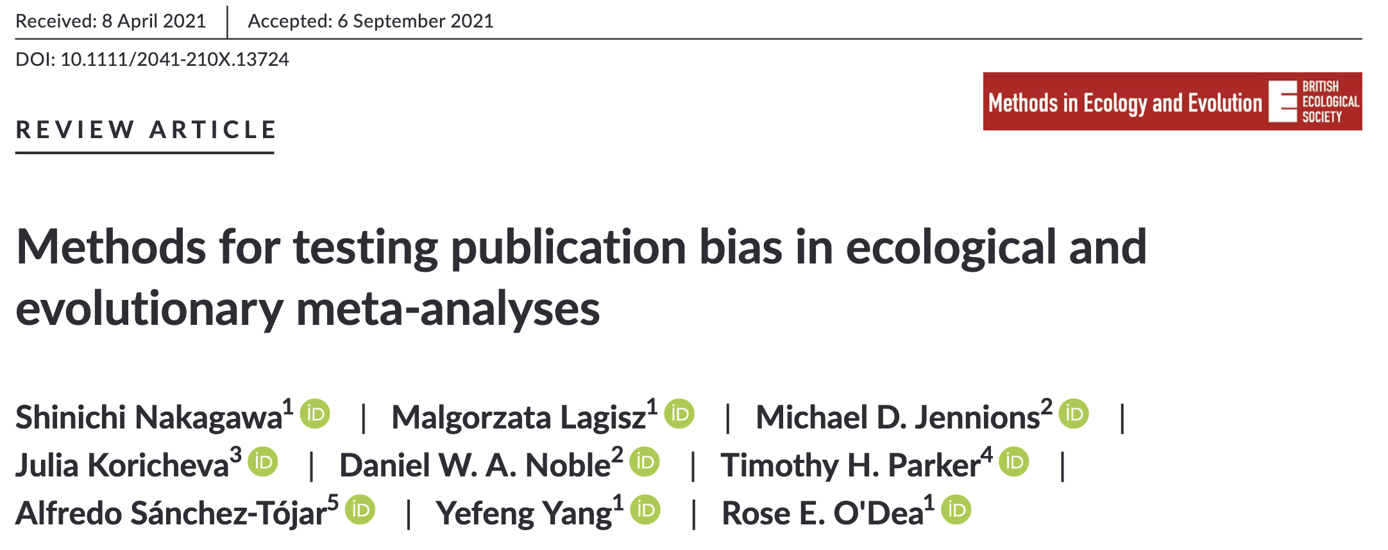


Slide 26


FOCUS ON TWO TYPE OF PUBLICATION BIAS:
outcome reporting bias –
when selective reporting occurs within published studies
(small-study effects)
time-lag bias –
when positive results are published earlier than negative results
(decline effects)

Slide 27

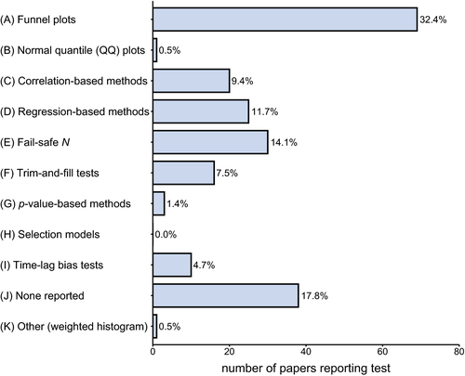


Survey of 102 meta-analyses in ecology and evolution (last 10 years):

Slide 28
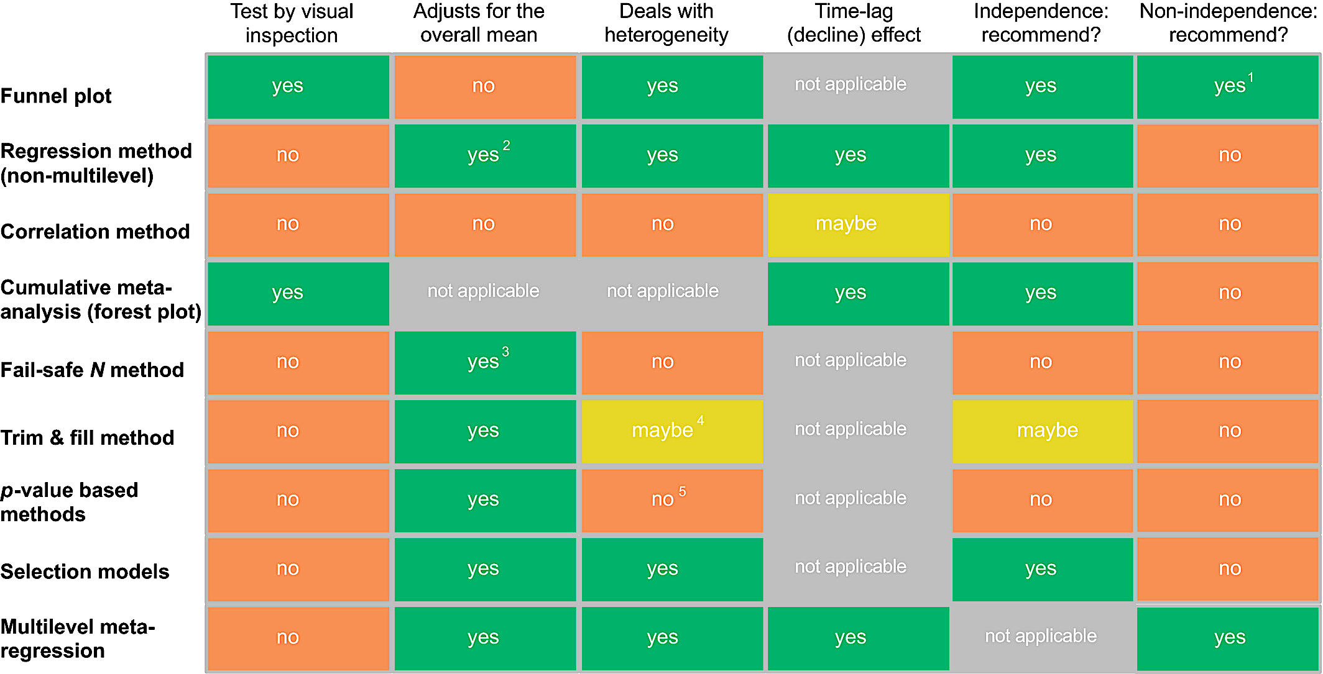

Slide 29


Slide 30
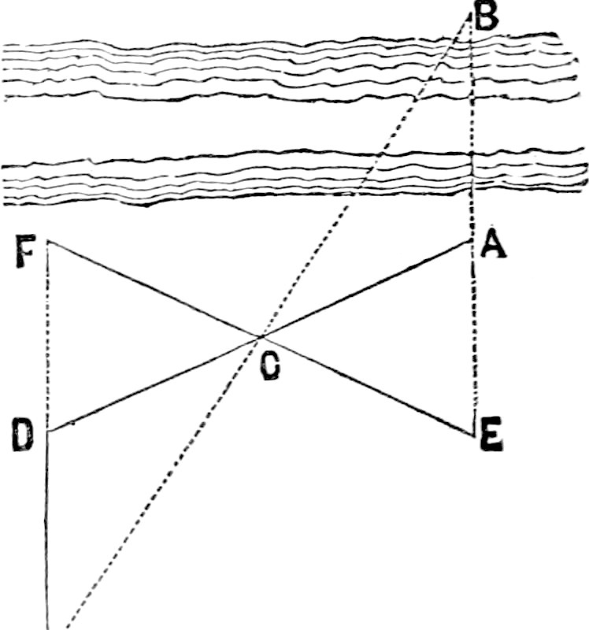
Introducing a new method: now pay attention!
PRESENTATION 3:
Yefeng Yang
11th July 2022

Slide 31
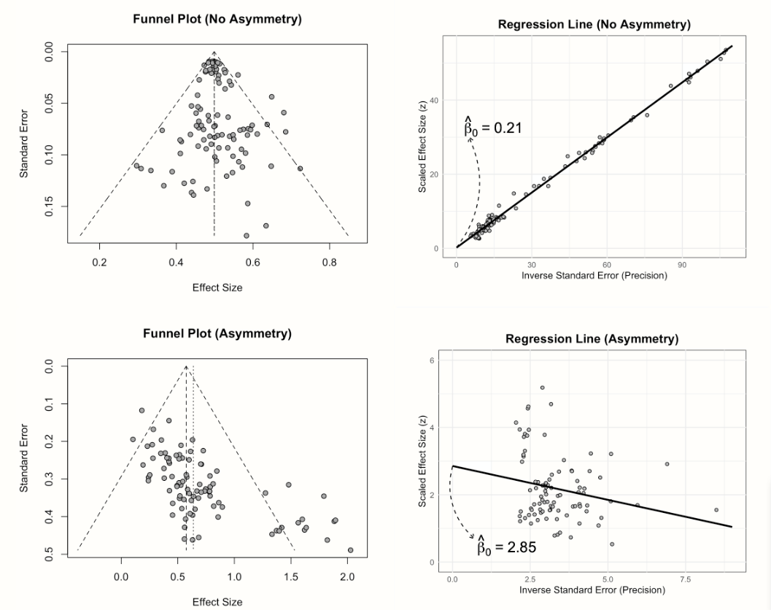
Asymmetry in funnel plots and its quantitative test
Figure source: Harrer M, Cuijpers P, Furukawa T A, et al. Doing meta-analysis with R: A hands-on guide[M]. Chapman and Hall/CRC, 2021.

Slide 32

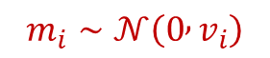
Egger’s test or Egger regression
A classic method that tests for asymmetry in the funnel plot
Intercept
Sampling error
Effect size estimates
$$y_{i}=β_{0}+β_{1}se_{i}+s_{i}+m_{i}$$
Sampling error effect
$$m_{i}∼𝒩\left(0 , v_{i}\right)$$
between-study effect
$$s_{i}∼𝒩\left(0 , σ_{s}^{2}\right)$$
Slope – indicator of asymmetry and small-study effects

Slide 33
Issues in existing methods for publication bias tests
High heterogeneity in dataset → false positive (Type I error rates)
Prevalent non-independence among effect sizes and sampling error → false positive (Type I error rates)
Low statistical power → false negative (Type II error rates)

Slide 34
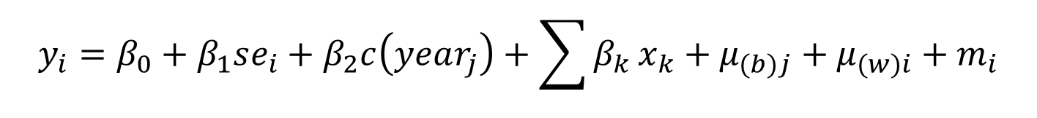
New method: an extended Egger’s regression
Test publication bias
Slope of publication year – indicator of decline effects
Sampling error
random-effects – account for non-independence
$$y_{i}=β_{0}+β_{1}se_{i}+β_{2}c\left(year_{j}\right)+\sum{β_{k}}x_{k}+μ_{(b)j}+μ_{(w)i}+m_{i}$$
Publication year
Fixed-effects – account for heterogeneity
Slope of sampling error – indicator of small-study effects
Note: replace sampling error by adapted sampling error (i.e., inverse square root effective sample size) when using log response ratio or standardised mean differences as effect size
Do not worry about the complex formulas
Several lines code can implement it!

Slide 35
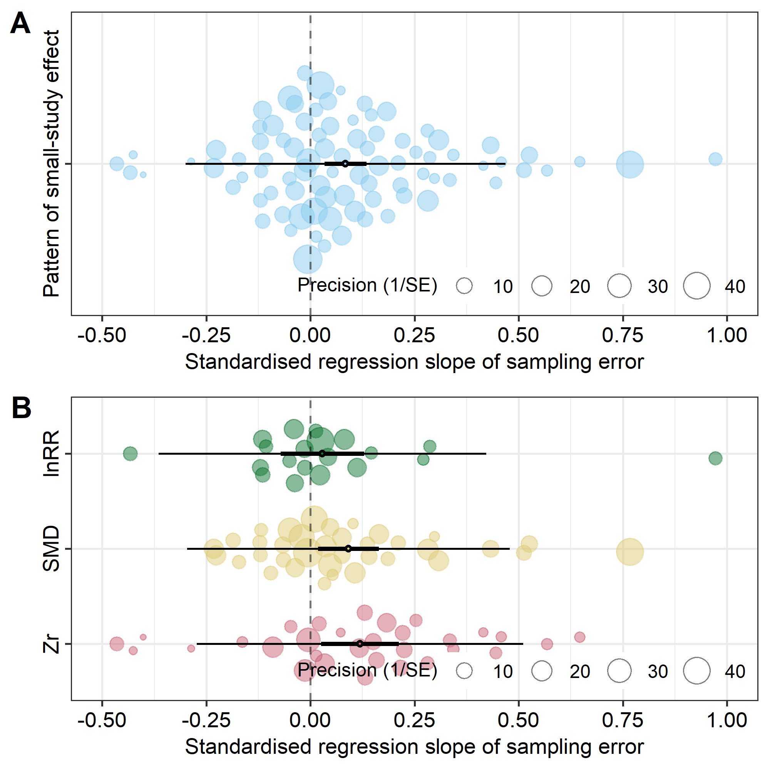
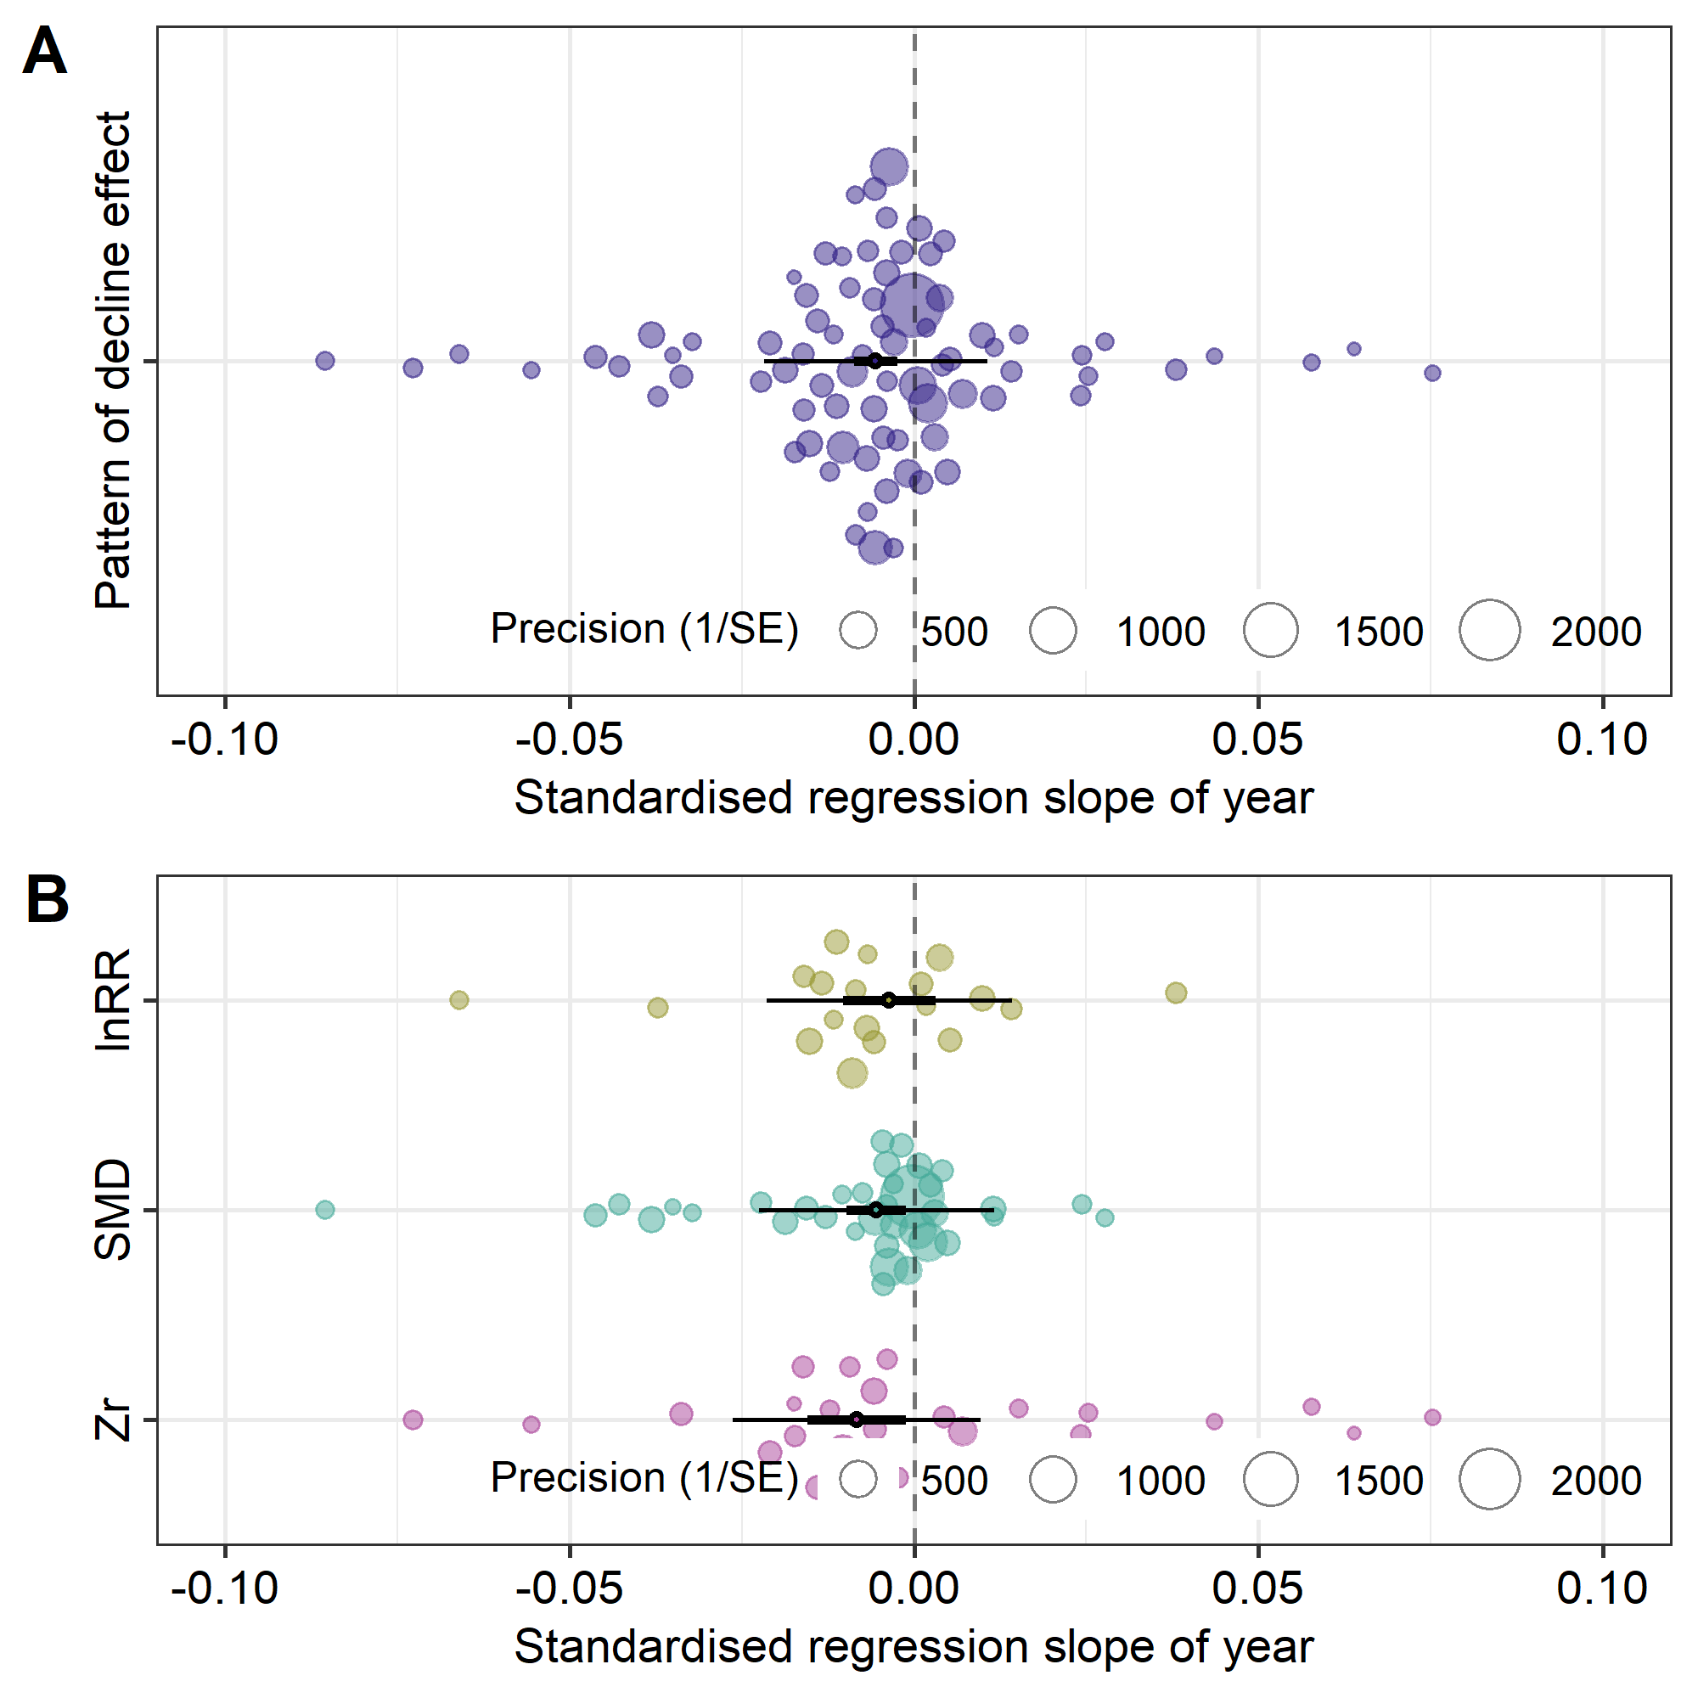
Large-scale investigation of publication bias using the new method
Publication bias is a general phenomenon!
Figure source: In-principle accepted Registered Report

Slide 36
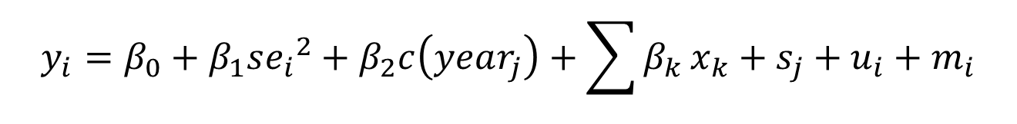
New method: an extended Egger’s regression
Adjust for publication bias
Intercept – “true” overall effect after correcting for publication bias (i.e., bias-corrected effect)
$$y_{i}=β_{0}+β_{1}{se_{i}}^{2}+β_{2}c\left(year_{j}\right)+\sum{β_{k}}x_{k}+s_{j}+u_{i}+m_{i}$$
Using average $year_{j}$ to account for time-lag bias → $c\left(year_{j}\right)$ = 0
infinite sampling size → infinite precision (1/$se_{i}$ ) → $se_{i}$ = 0 → ${se_{i}}^{2}$ = 0
Note: replace sampling variance by adapted sampling variance (i.e., inverse effective sample size) when using log response ratio or standardised mean differences as effect size

Slide 37
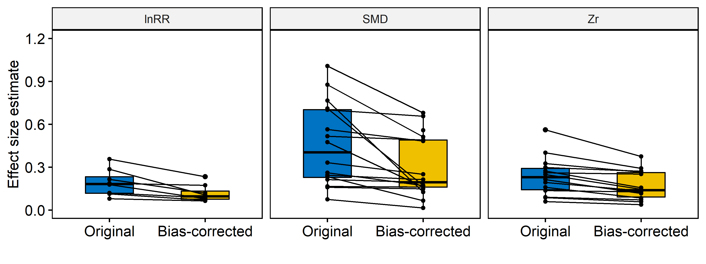
Empirically correct for publication bias using the new method
The effect size estimates have a statistically significant decline after correcting for publication bias
(by at least 0.2 SDs)
Figure source: In-principle accepted Registered Report

Slide 38
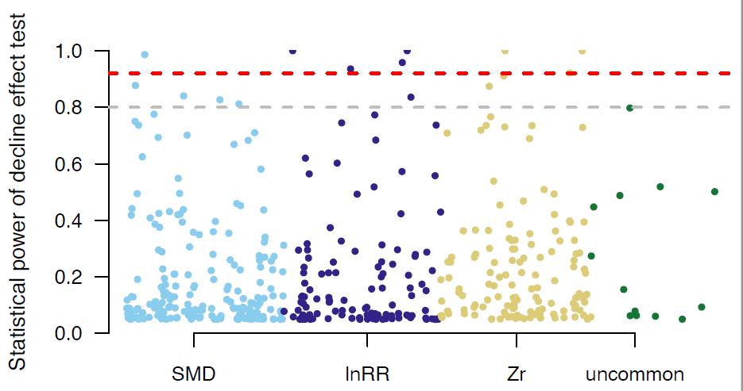
Observed power of publication bias test methods
Report publication bias
Median power = ~20%
Shift interpretation philosophy:
dichotomous decision (hypothesis test) vs. estimate (magnitude and precision)
Statistical significance vs. ‘ biological’ or ‘practical’ significance
Figure source: Yang Y, Lagisz M, Nakagawa S. Decline effects are rare in ecology: Comment[J]. 2022.

Slide 39
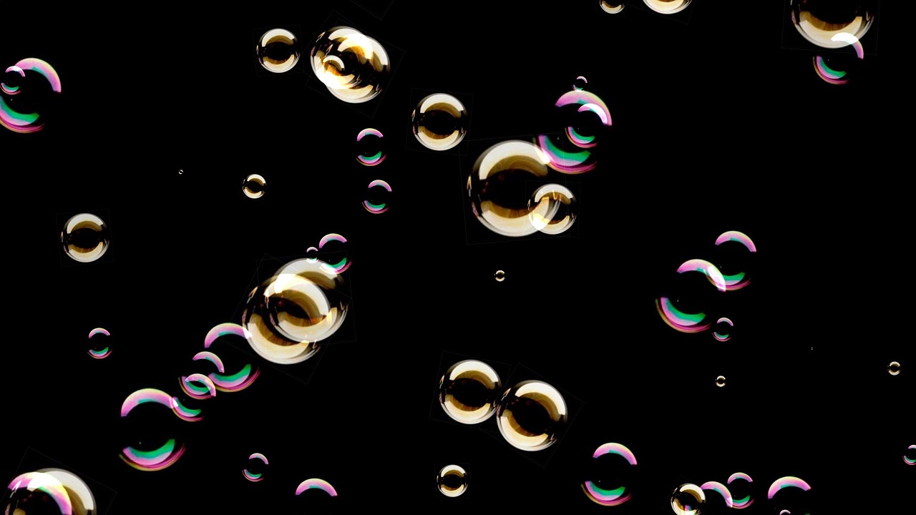

Slide 40

How does this look in R? lets have a look…
PRESENTATION 4:
Yefeng Yang
11th July 2022

